Slide 1

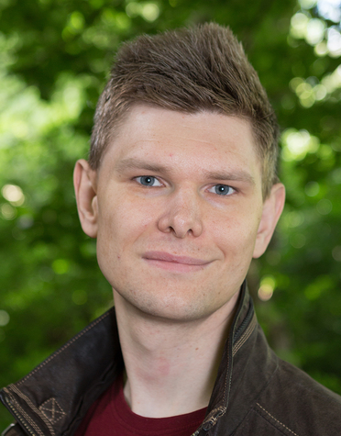

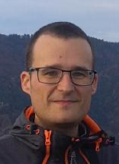
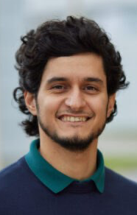


https://mcstas.org
Total presentation time is 3 minutes
https://mcxtrace.org
https://github.com/mccode-dev/McCode
Team
Peter Willendrup DTU / ESS DMSC
Mads Bertelsen ESS DMSC
Gregory S Tucker ESS DMSC
Emmanuel Farhi Synchrotron SOLEIL
Tobias Weber Institut Laue-Langevin
José Robledo FZ Jülich / IAS / JSC
Team Mentors
Jan-Oliver Mirus FZ Jülich / IAS / JSC
Ilya Zhukov FZ Jülich / IAS / JSC

Slide 2
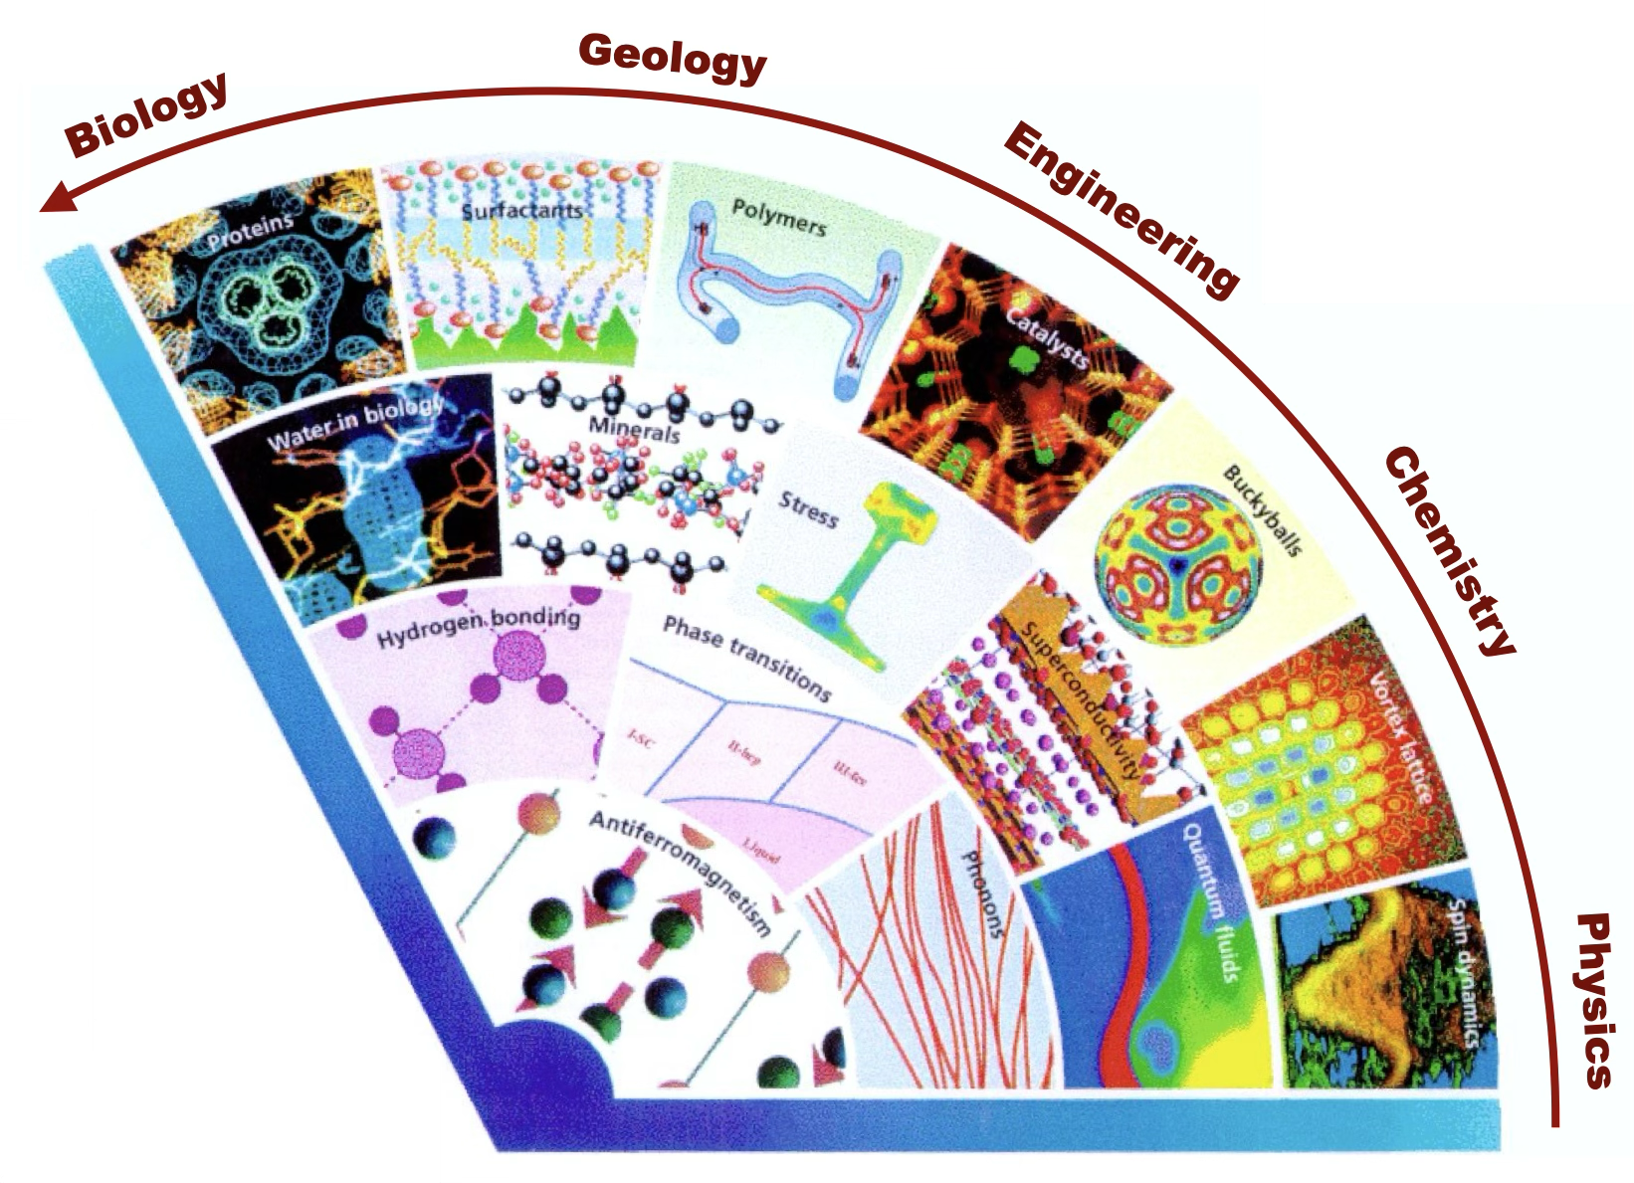
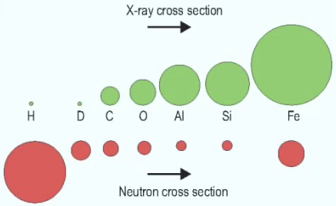
McStas (neutrons) and McXtrace (X-rays)
‘Particle beams to probe condensed matter’, design ‘scattering instrumentation’ at user facilities. N: research reactors, spallation sources, X: labs, synchrotrons, FELs, space telescopes
Tell us about your application:
Algorithmic motif: Monte Carlo ray-tracing
Language is (lex/yacc) DSL ISO C
Libraries – mostly ‘internal’ but some GSL, Xraylib, MCPL, NCrystal
Focus: Compute performance tuning, finding bottlenecks
GPU port via OpenACC, ~ 95% functional via:
Dresden Hackathon 2017, Espoo Hackathon 2019, own efforts.
cogen

Slide 3

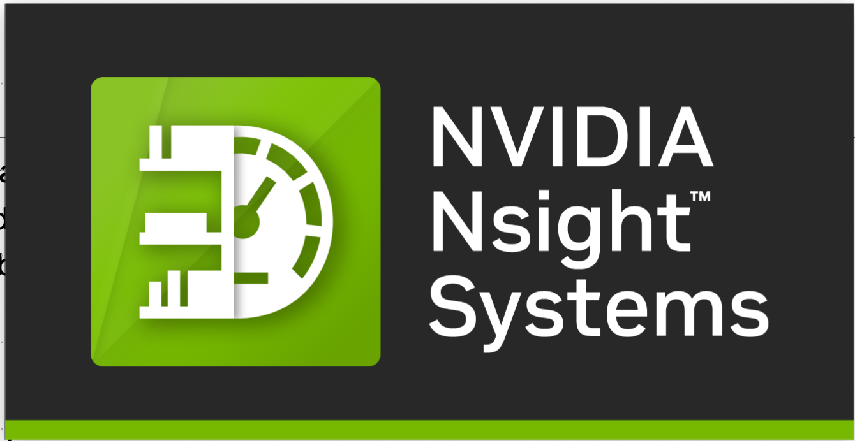
Goals
Learn to practically use, (master?) the Nvidia profilers/performance tools
Get a better understanding of the limitations of the current implementation
Try to identify obvious bottlenecks
Get ideas!
Hack!
Optimize!
Run simulations!
Have fun! :-)

